Slide 1
Number System

Slide 2


Common Number System
System | Base | Symbols | Used by humans? | Used in computers?
Decimal | 10 | 0, 1, … 9 | Yes | No
Binary | 2 | 0, 1 | No | Yes
Octal | 8 | 0, 1, … 7 | No | No
Hexa- decimal | 16 | 0, 1, … 9, A, B, … F | No | No

Slide 3


Counting
Decimal | Binary | Octal | Hexa- decimal
0 | 0 | 0 | 0
1 | 1 | 1 | 1
2 | 10 | 2 | 2
3 | 11 | 3 | 3
4 | 100 | 4 | 4
5 | 101 | 5 | 5
6 | 110 | 6 | 6
7 | 111 | 7 | 7

Slide 4
Counting
Decimal | Binary | Octal | Hexa- decimal
8 | 1000 | 10 | 8
9 | 1001 | 11 | 9
10 | 1010 | 12 | A
11 | 1011 | 13 | B
12 | 1100 | 14 | C
13 | 1101 | 15 | D
14 | 1110 | 16 | E
15 | 1111 | 17 | F

Slide 5
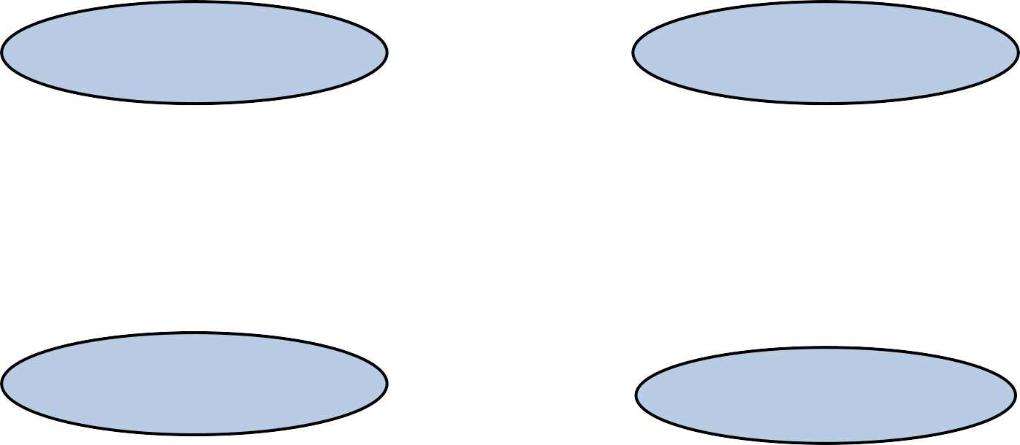
Conversion Among Bases
Decimal
Octal
Binary
Hexadecimal

Slide 6
Binary to Octal
Group into 3's starting at least significant symbol (if the number of bits is not evenly divisible by 3, then add 0's at the most significant end)
write 1 octal digit for each group e.g.: (1010101)₂ to ( )₈
001 | 010 | 101
1 | 2 | 5
Answer = 125₈

Slide 7
Octal to Binary
For each of the Octal digit write its binary equivalent e.g.: (257)₈ to ( )₂
2 5 7
010
111
101
Answer = (010101111)₂

Slide 8
Binary to Hexadecimal
Group into 4's starting at least significant symbol (if the number of bits is not evenly divisible by 4, then add 0's at the most significant end)
write 1 hex digit for each group. e.g.: (1010111011)₂ to ( )₁₆
10 1011 1011
2 B
Answer = (2BB)₁₆
B

Slide 9
Hexadecimal to Binary
For each of the Hex digit write its binary equivalent (use 4 bits to represent).
e.g.: (25A0)₁₆ to ( )₂
2 5 A 0
0010
0000
0101 1010
Answer = (0010010110100000)₂

Slide 10
Octal to Hexadecimal
Steps:
Convert octal number to its binary equivalent
Convert binary number to its hexadecimal equivalent e.g.: (635.27)₈ to ( )₁₆
6 3 5 . 2 7
000
110 011 101 . 010 111
00
1 | 9 | D | . | 5 | C

Slide 11
Hexadecimal to Octal
Steps:
Convert hexadecimal number to its binary equivalent
Convert binary number to its octal equivalent e.g.:
A | 3 | B . 7
1010 | 0011 | 1011 . 0111
00
5 | 0 | 7 | 3 | . | 3 | 4

Slide 12
Any Base to Decimal
Converting from any base to decimal is done by multiplying each digit by its weight and summing.
e.g.:
Binary to Decimal
1011.11₂ = (1x2³ ) + (0x2² ) + (1x2¹ ) + (1x2⁰) + (1x2⁻¹) + (1x2⁻²)
= 8 + 0 + 2 + 1 + 0.5 + 0.25
= 11.75₁₀

Slide 13
Decimal to Any Base
Steps:
Convert integer part
( Successive Division Method )
Convert fractional part
( Successive Multiplication Method )

Slide 14
Steps in Successive Division Method
Divide the integer part of decimal number by desired base number, store quotient (Q) and remainder (R)
Consider quotient as a new decimal number and repeat step1 until quotient becomes 0
List the remainders in the reverse order
Steps in Successive Multiplication Method
Multiply the fractional part of decimal number by desired base number
Record the integer part of product as carry and fractional part as new fractional part
Repeat steps 1 and 2 until fractional part of product becomes 0 or until you have many digits as necessary for your application
Read carries downwards to get desired base number

Slide 15
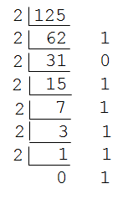
e.g.: (125)₁₀ to ( )₂
Answer : (1111101)₂

Slide 16
1’s Complement
The 1’s complement of a binary number is the number that results when we change all 1’s to zeros and the zeros to ones.
1 | 1 | 0 | 1 | 0 | 0 | 1 | 0
NOT OPEARATION
0 | 0 | 1 | 0 | 1 | 1 | 0 | 1

Slide 17
2’s Complement
The 2’s complement the binary number that results when add 1 to the 1’s complement. It’s given as,
2’s complement = 1’s complement + 1
Example: Express 35 in 8-bit 2’s complement form. Solution:
35 in 8-bit form is 00100011
0 0 1 0 0 0 1 1
1 1 0 1 1 1 0 0
+ 1
1 1 0 1 1 1 0 1

Slide 18
9’s Complement
The nines' complement of a decimal digit is the number that must be added to it to produce 9. The complement of 3 is 6, the complement of 7 is 2.
Example: Obtain 9’s complement of 7493 Solution:
9 9 9 9
- 7 4 9 3
2 5 0 6
9’s complement

Slide 19
10’s Complement
The 10’s complement of the given number is obtained by adding 1 to the 9’s complement. It is given as,
10’s complement = 9’s complement + 1
Example: Obtain 10’s complement of 7493 Solution:
9 9 9 9 |  | 2 5 0 6
- 7 4 9 3 | + | 1
2 5 0 6
2 5 0 7
10’s complement

Slide 20
Binary Addition
Sr no. | Operations
0. | 0+0=0
1. | 0+1=1
2. | 1+0=1
3. | 1+1=10 (0 with carry of 1)
In the last case, sum is of two digits: Higher Significant bit is called Carry and lower significant bit is called Sum.

Slide 21
Binary Addition
e.g.:
1
+ 0
1
1
0
1
0
0
1 0
0
1 0
Carry

Slide 22
Binary Subtraction
The subtraction consists of four possible elementary operations:
Sr no. | Operations
0. | 0-0=0
1. | 0-1=1(borrow 1)
2. | 1-0=1
3. | 1-1=0
In case of second operation the minuend bit is smaller than the subtrahend bit, hence 1 is borrowed.

Slide 23
Binary Subtraction
e.g.:
0
- 0
1
1
0
1
1
0
1
1
1 1

Slide 24
Binary Multiplication
Rules for Binary Multiplication are:
Sr no. | Operations
0. | 0*0=0
1. | 0*1=0
2. | 1*0=0
3. | 1*1=1
e.g.: Multiply 110 by 10
1 1
1
0
0
*
0 0 0
+ 1 1 0 0
1 1 0 0

Slide 25
Binary Division
Rules for Binary Division are:
Sr no. | Operations
0. | 0/0=0
1. | 1/0=0
2. | 0/1=0
3. | 1/1=1
e.g.:
Divide 110 by 10
1 1
1 0 1 1 0
1 0
0 1 0
1 0
0 0

